Slide 1
Listening and integrated skills A2
Instructor: Nguyen Ha Phuong

Slide 2
Unit 7: The human body
Pages 121-140

Slide 3
Lesson objectives
By the end of the lesson, students will be able to:
compare ancient and modern humans and make predictions about humans.
respond to a listening about good bacteria.
recognize words with multiple meanings.
understand time periods.
use an outline.
recognize reduced forms.

Slide 4
TABLE OF CONTENTS
01
02
03
04
05
VOCABULARY A
LISTENING A
VIDEO WATCHING
VOCABULARY B
LISTENING B

Slide 5
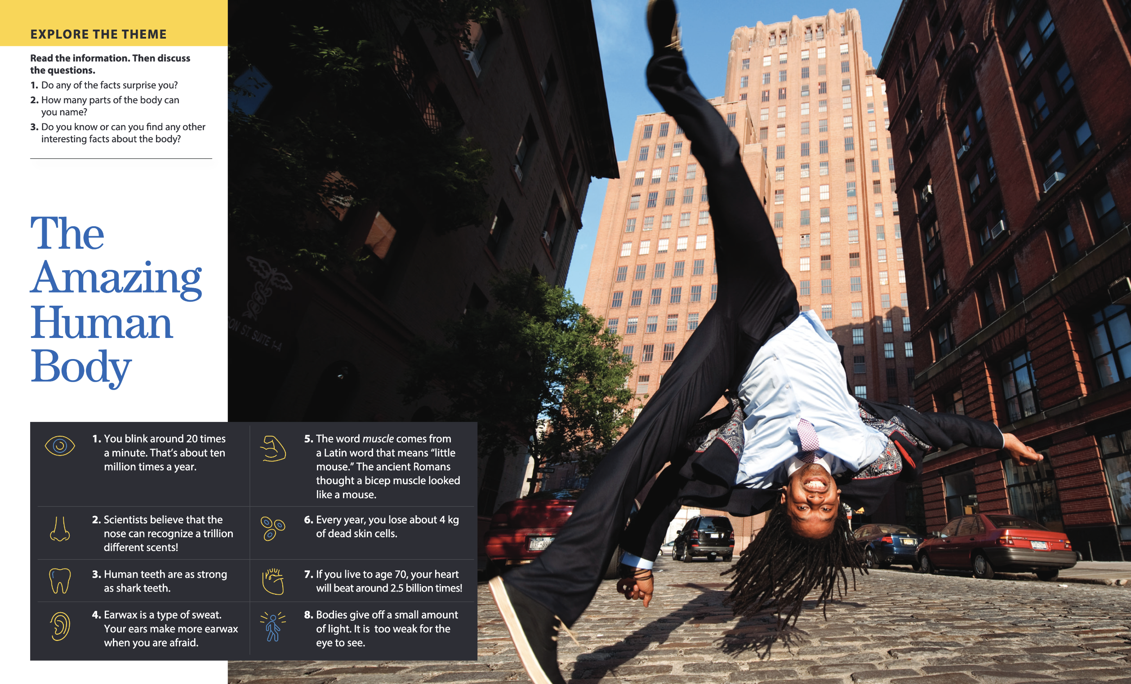

Slide 6

01
Vocabulary A

Slide 7

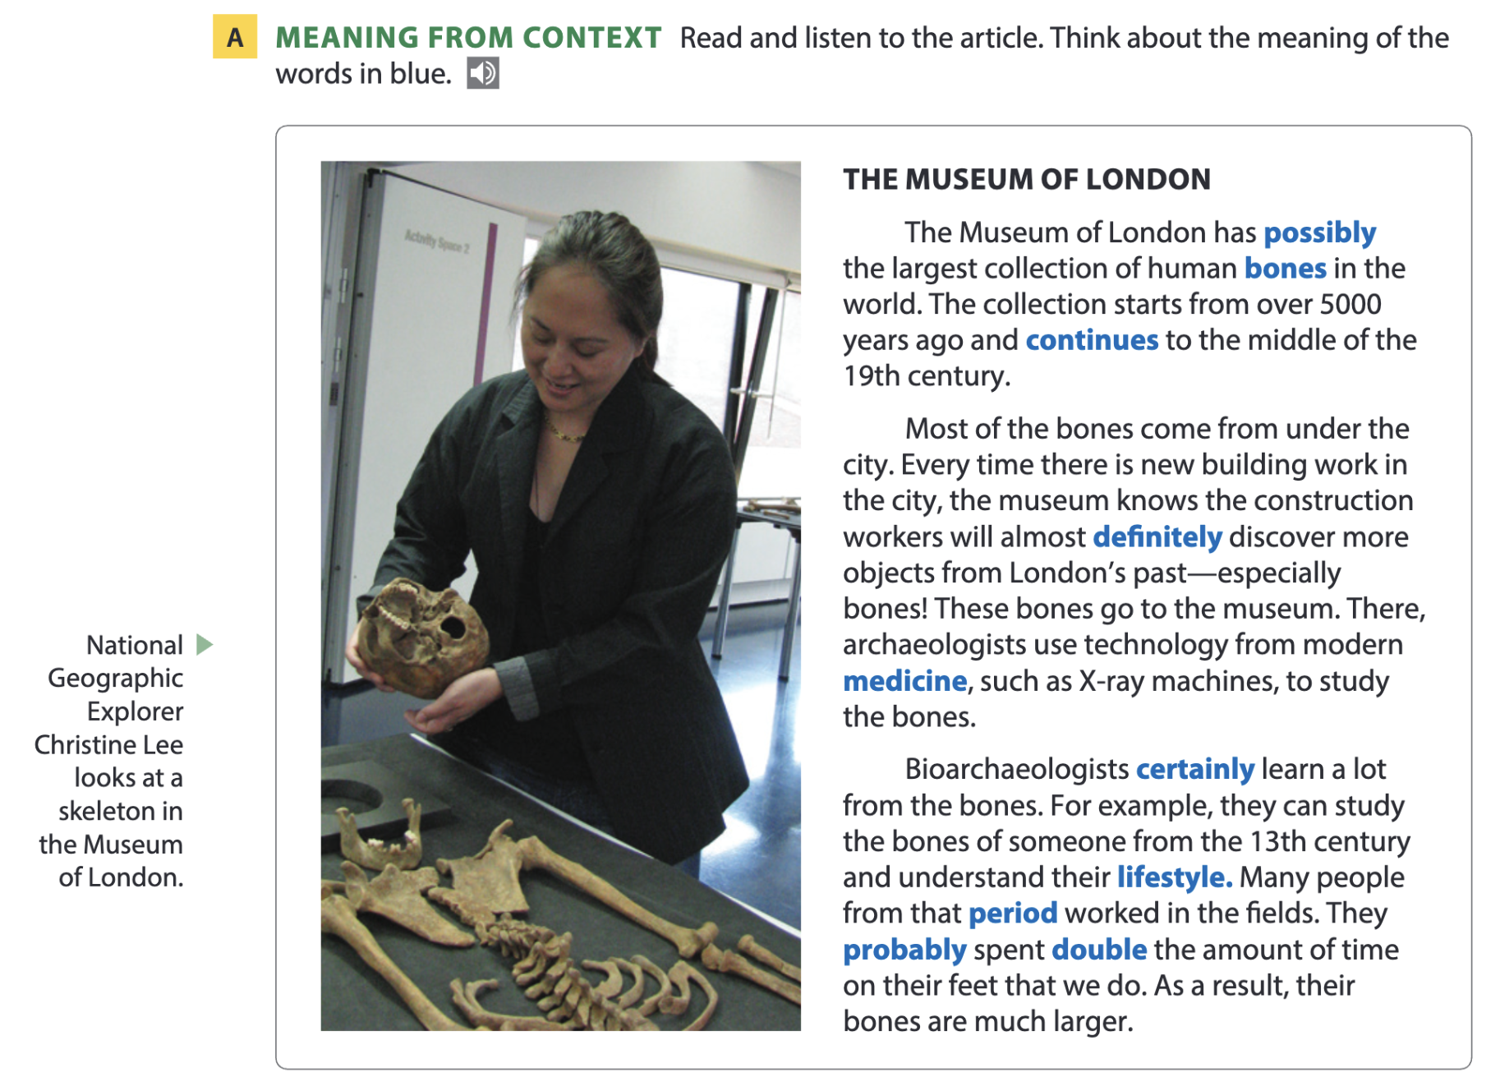
Page 124

Slide 8
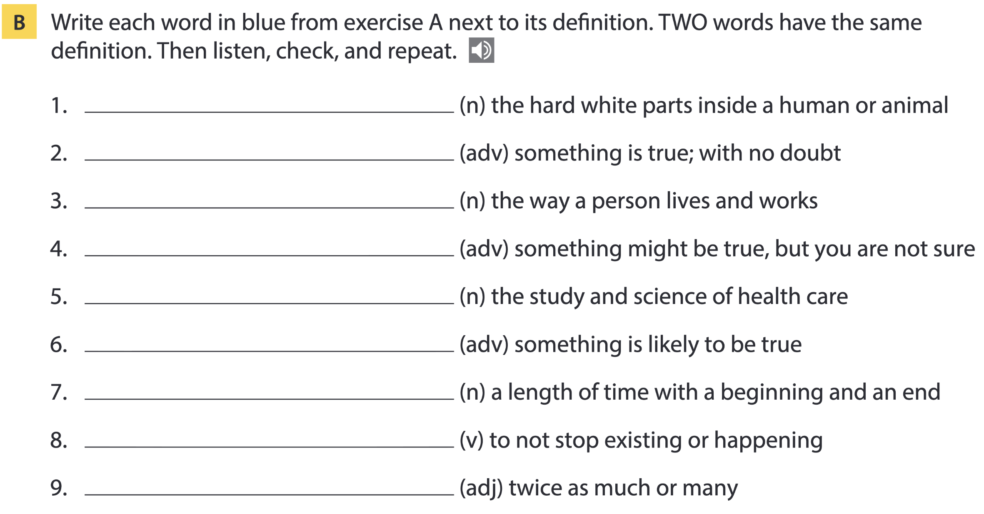
Page 124
bones
definitely; certainly
lifestyle
possibly
medicine
probably
period
continue
double

Slide 9
Word list
bones /bəʊnz/ (n): xương
definitely /ˈdefɪnətli/; certainly /ˈsɜːtnli/ (adv): chắc chắn
lifestyle /ˈlaɪfstaɪl/ (n): lối sống
possibly /ˈpɒsəbli/ (adv): có thể, có khả năng
medicine /ˈmedsn/ (n): y học; thuốc
probably /ˈprɒbəbli/ (adv): có lẽ
period /ˈpɪəriəd/ (n): giai đoạn, thời kỳ
continue /kənˈtɪnjuː/ (v): tiếp tục
double /ˈdʌbl/ (adj): gấp đôi

Slide 10
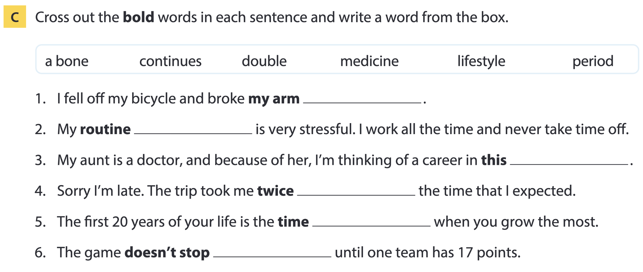
Page 125
a bone
lifestyle
medicine
double
period
continues

Slide 11
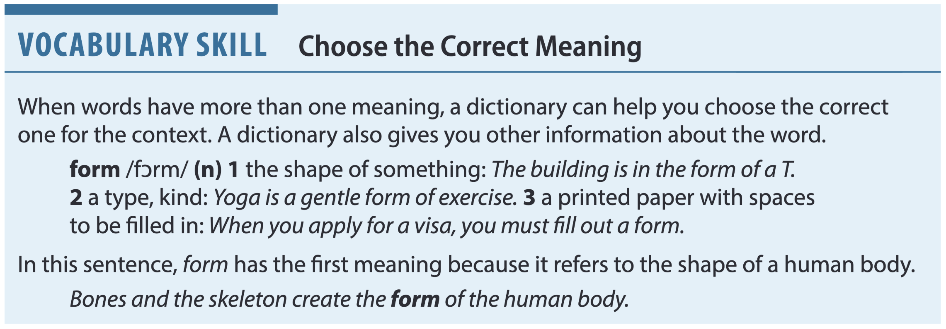
Page 125

Slide 12
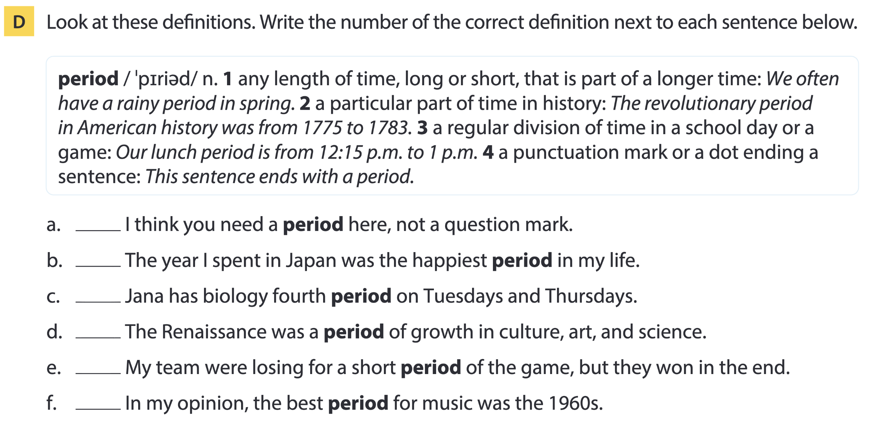
Page 125
4
1
3
2
1
2

Slide 13
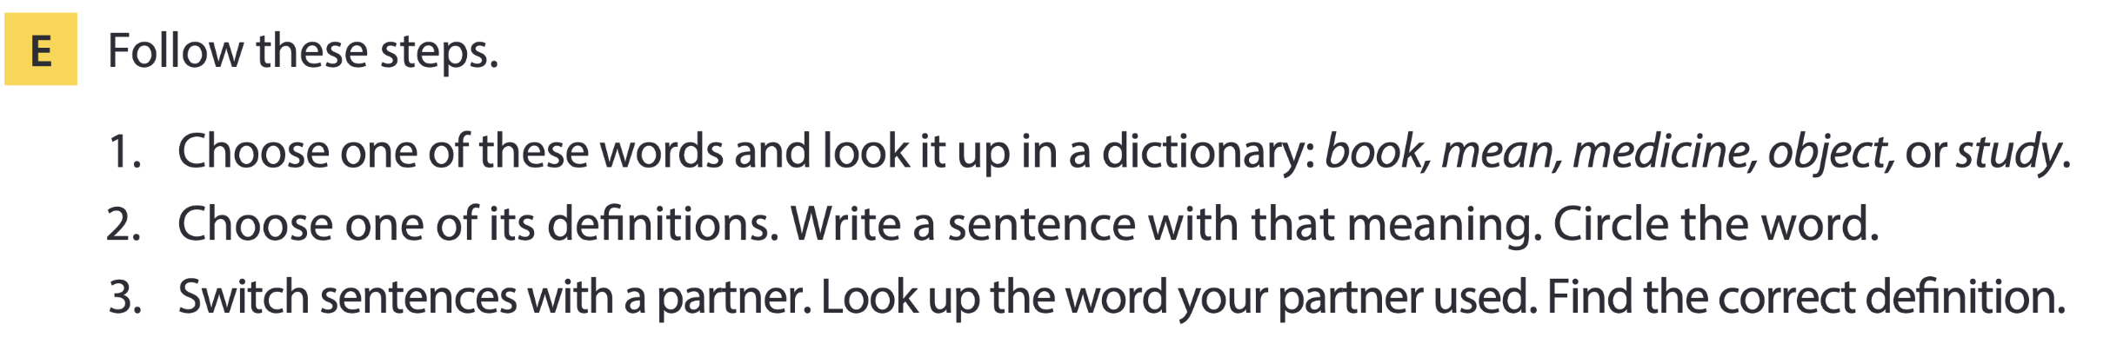
Page 125

Slide 14

02
Listening A

Slide 15
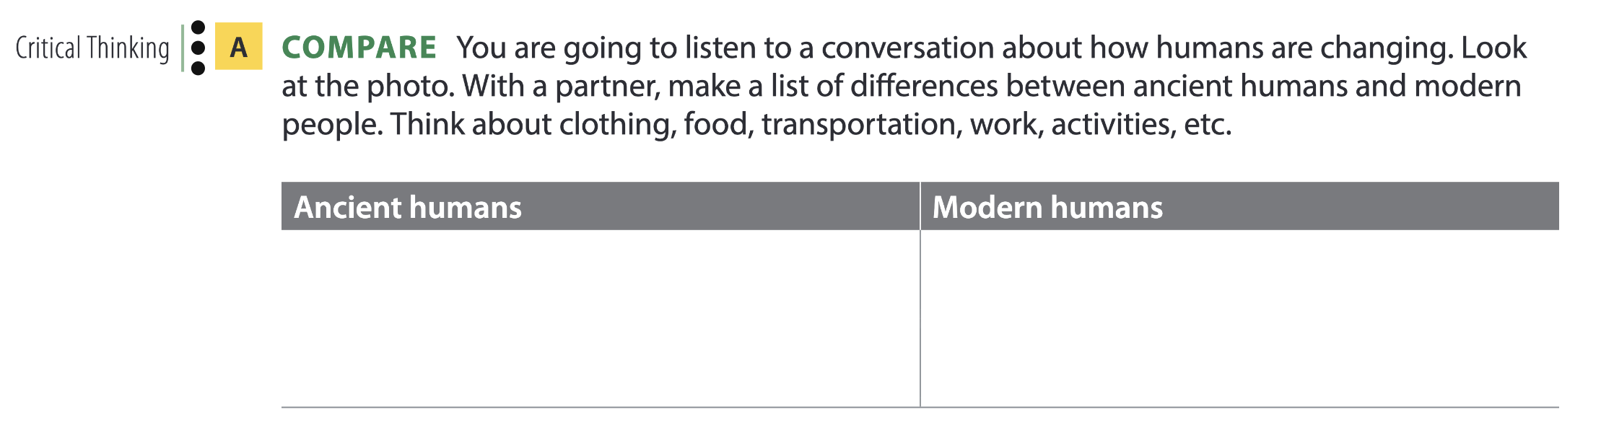
How humans are changing
had to look and hunt for food, made their own clothes, lived in caves, used transportation like horses, did a lot of physical work
Possible answers
grow food, have shops, live in houses, have cars and public transportation, don’t do a lot of physical work

Slide 16
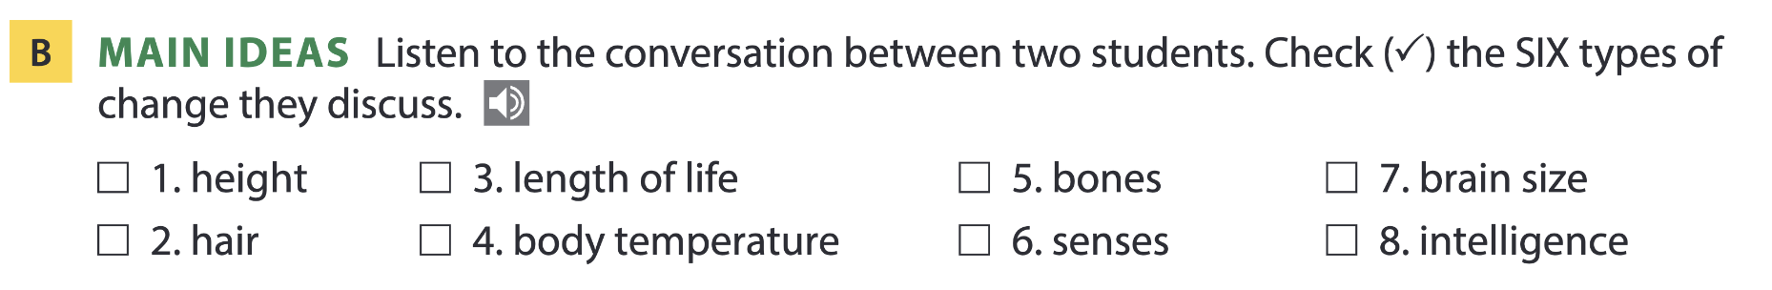

Page 126

Slide 17
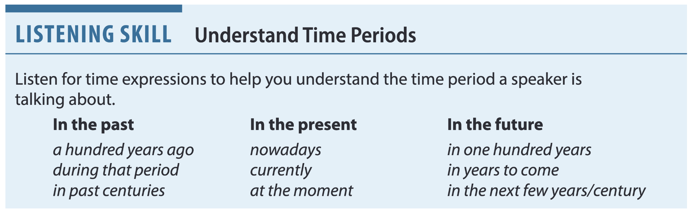
Page 126

Slide 18
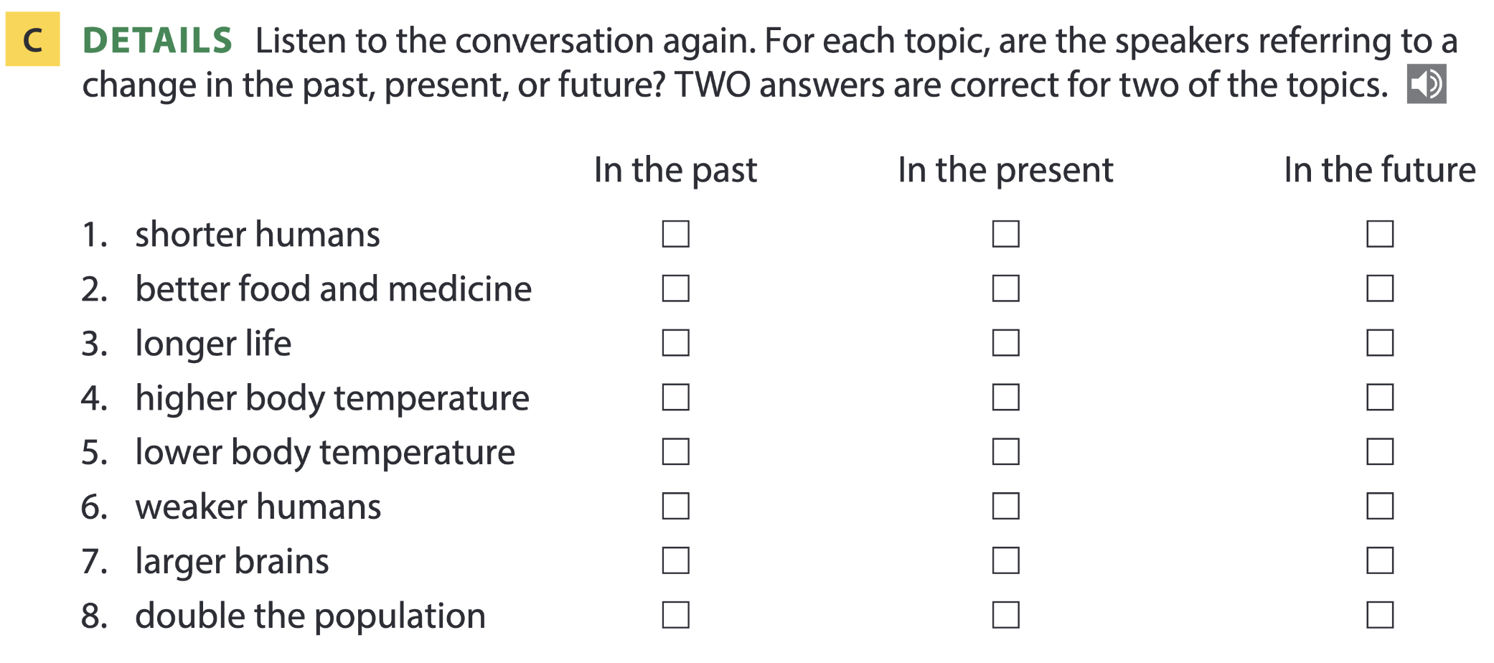
Page 126

Slide 19

Listening for numbers
How do you say these numbers?
60
16
2025
2050
0.25
10.75
Sixty
Sixteen
Twenty twenty-five (more common) / two thousand twenty-five
Twenty fifty
Zero point two five / nought point two five (British English) / a quarter (if referring to a fraction)
Ten point seven five / ten and three quarters (if referring to a fraction)

Slide 20
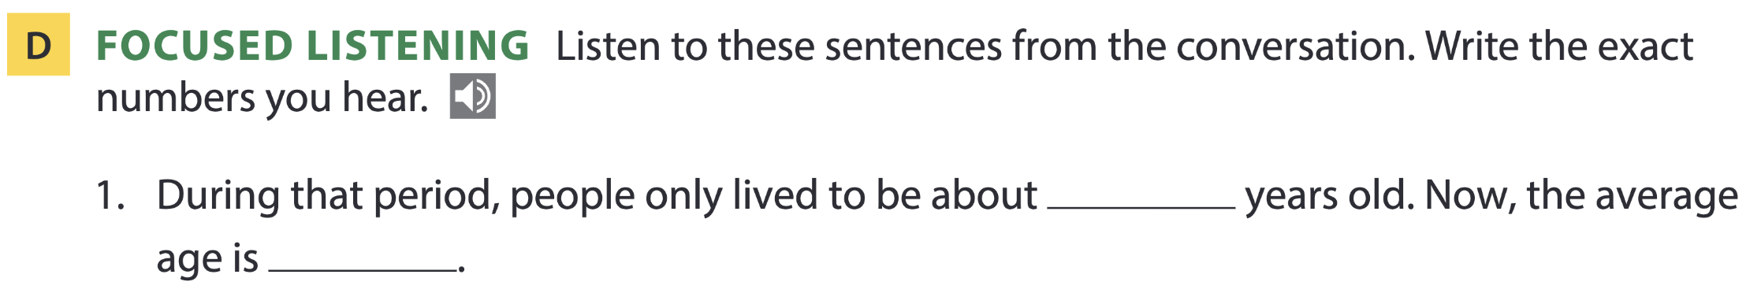
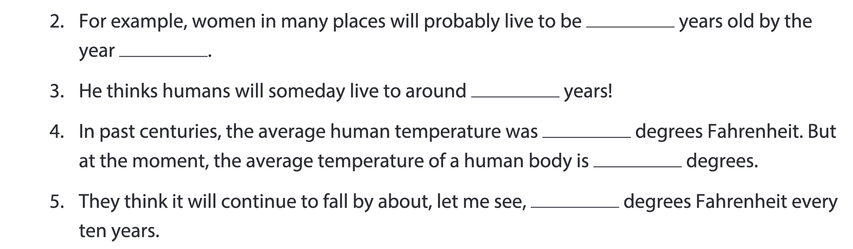
Pages 126-127
30
70
85
2030
130
98.6
97.9
0.05

Slide 21
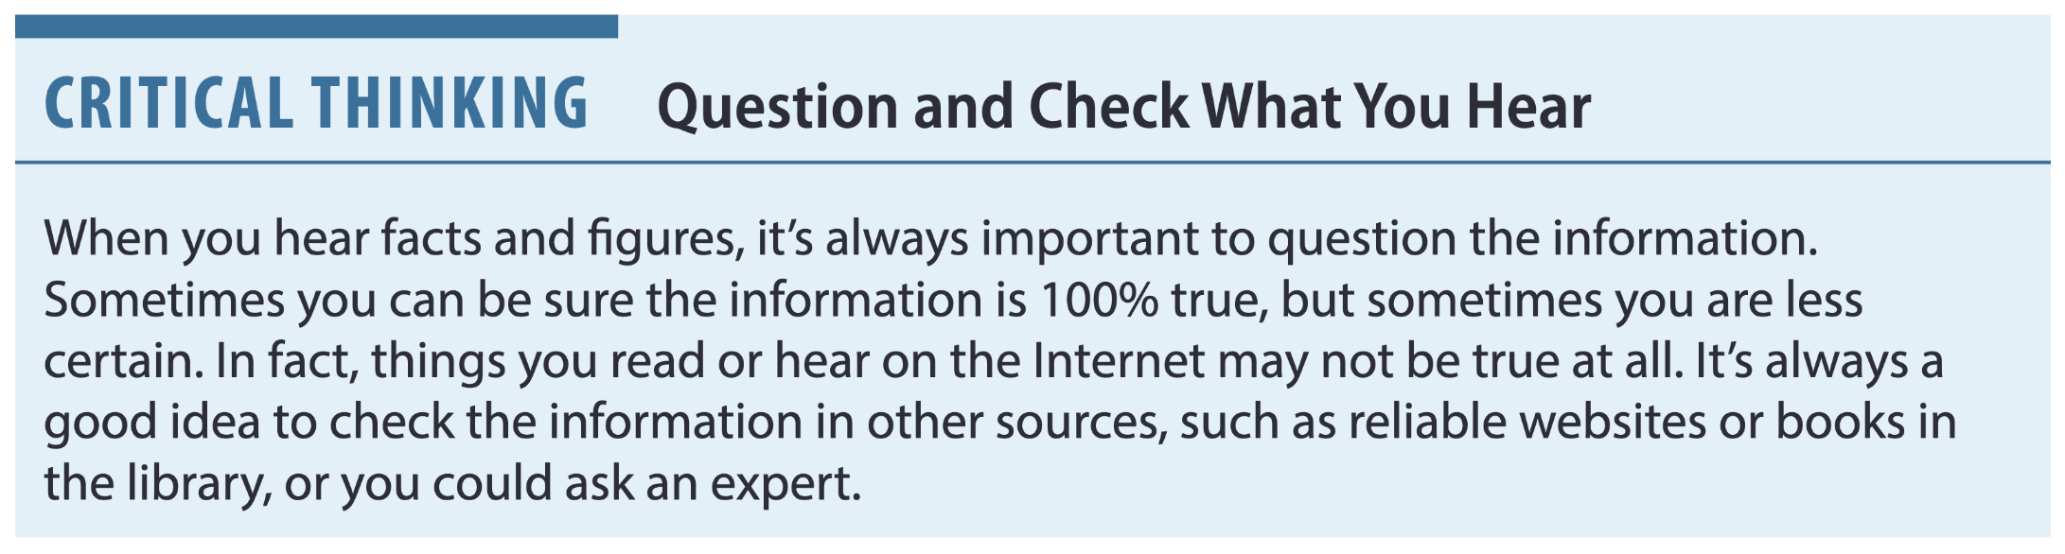
Page 127

Slide 22
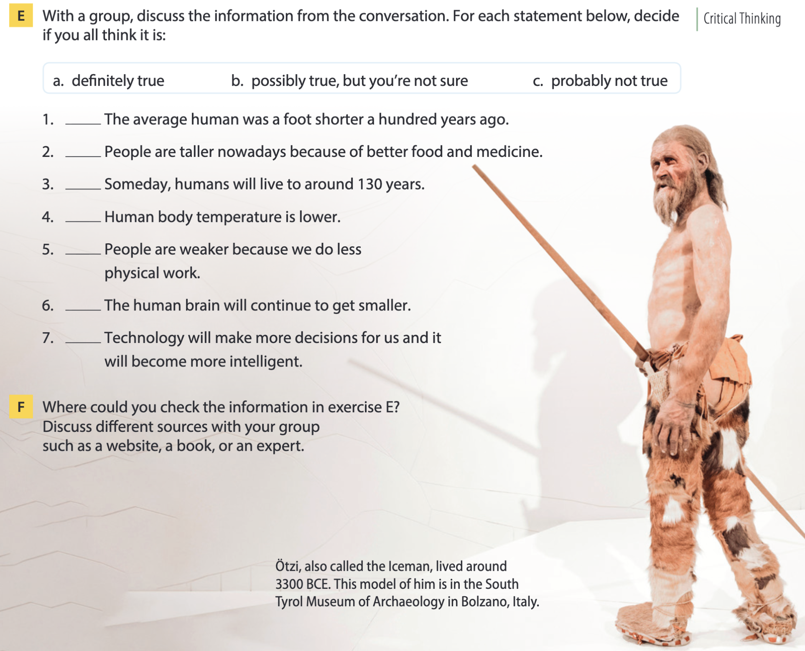
Page 127

Slide 23

03
Video watching

Slide 24
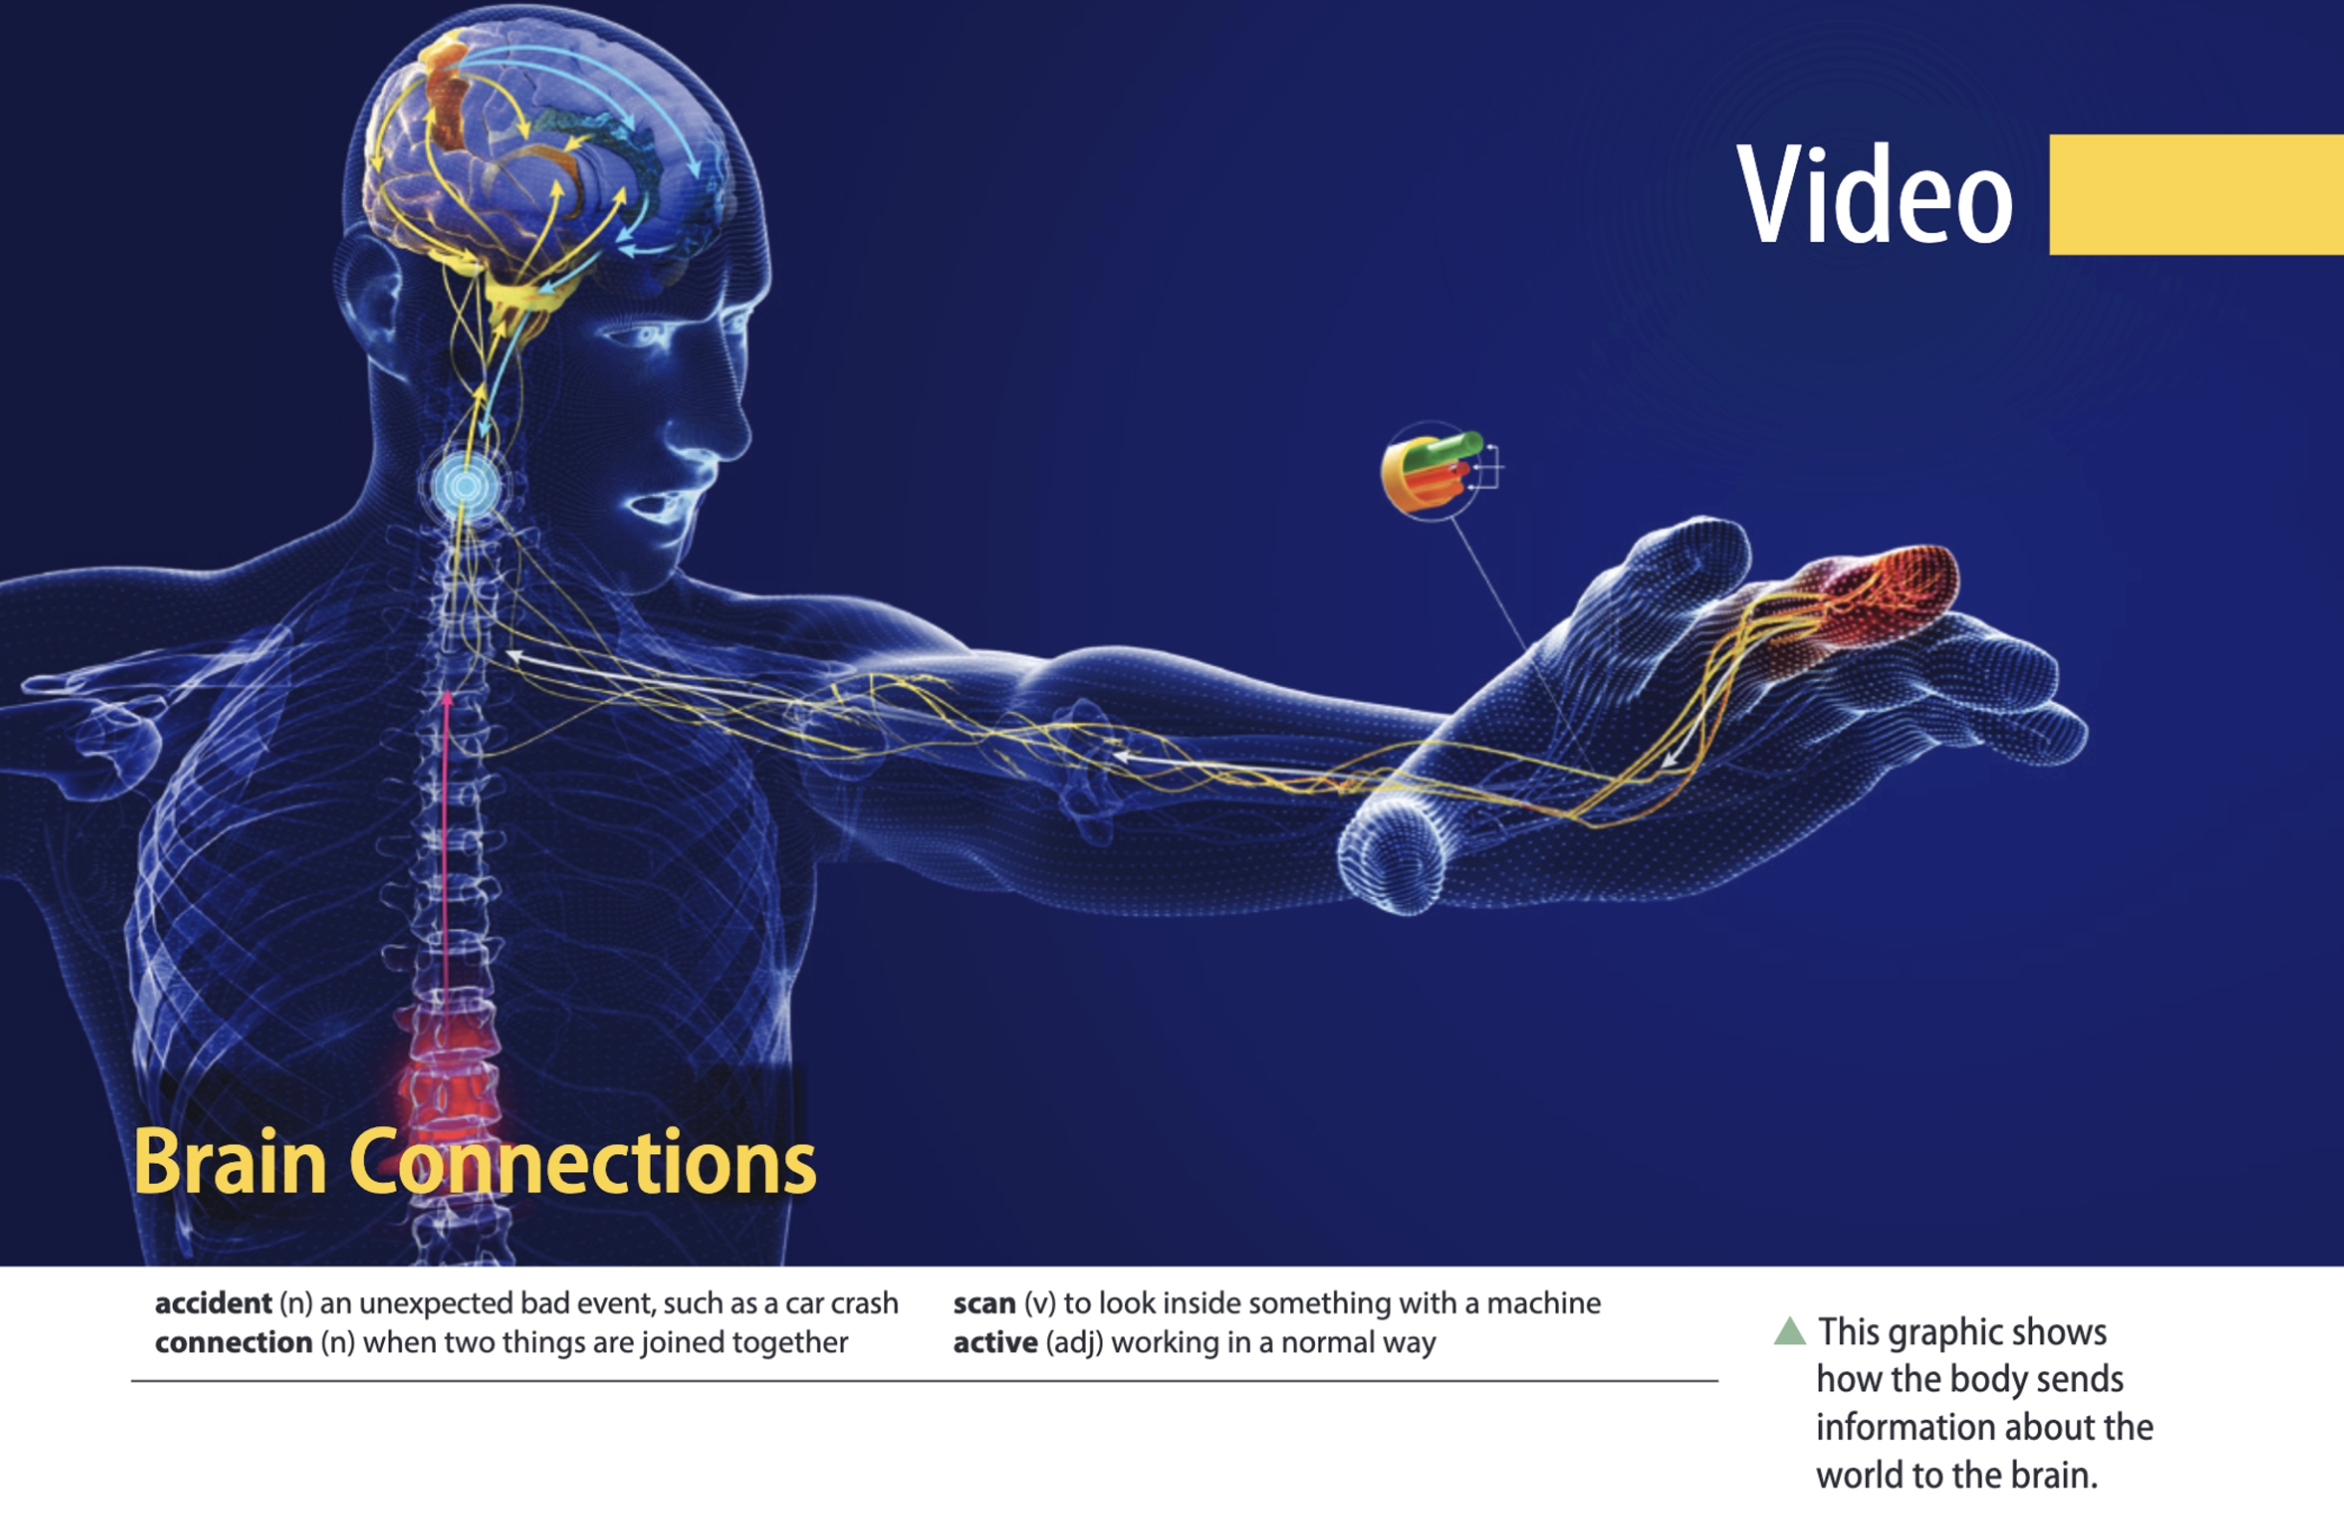

Slide 25
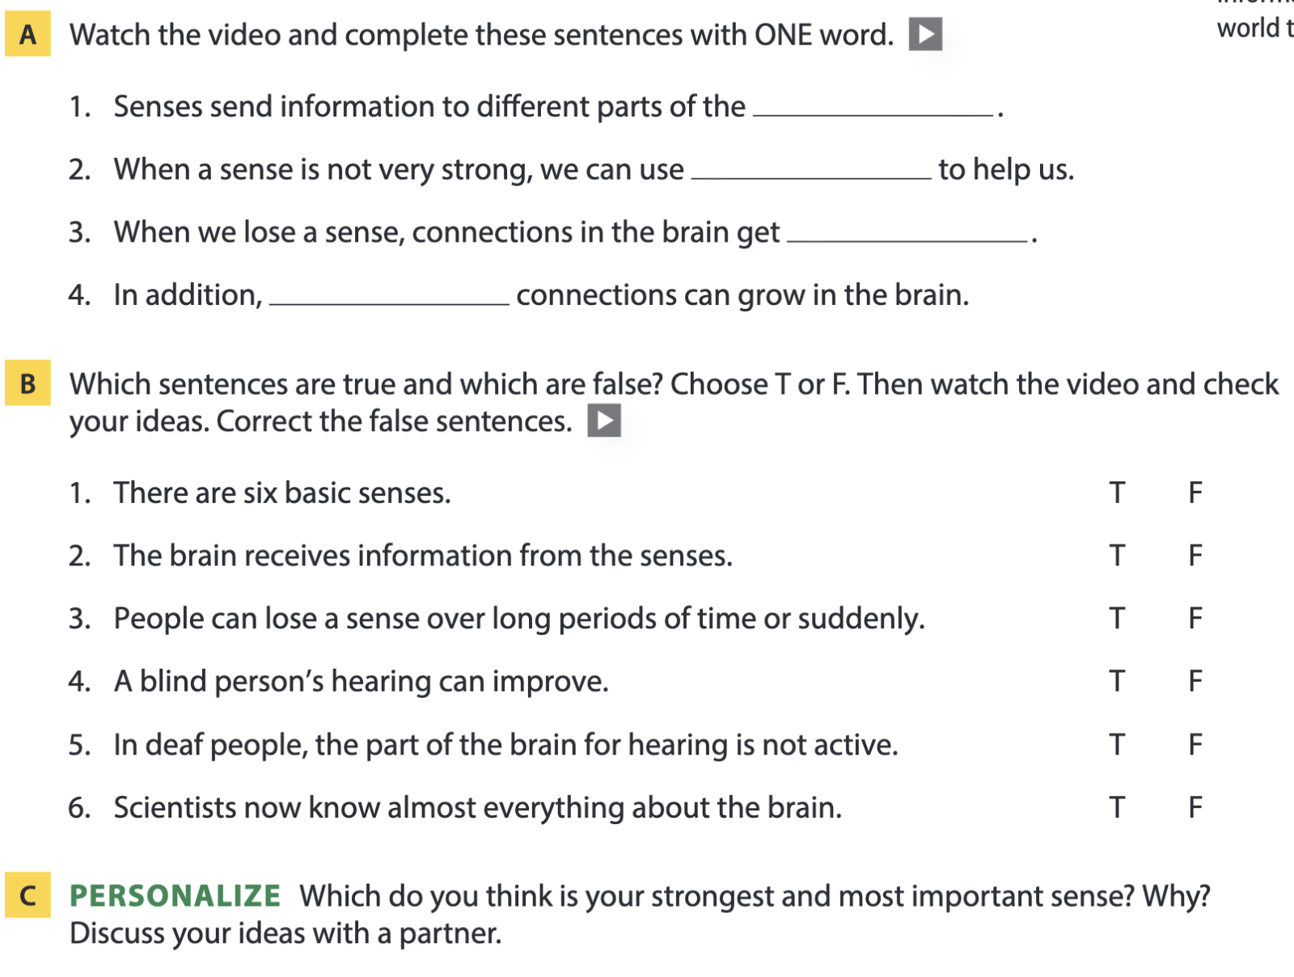
Page 131
brain
medicine
stronger
new
five
don’t

Slide 26
04
Vocabulary B

Slide 27
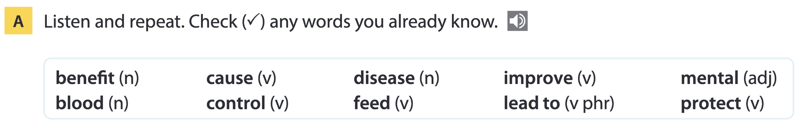
Page 132

Slide 28
Word list
benefit /ˈbenɪfɪt/ (n): lợi ích
blood /blʌd/ (n): máu
cause /kɔːz/ (v): gây ra
control /kənˈtrəʊl/ (v): kiểm soát
disease /dɪˈziːz/ (n): bệnh, dịch bệnh
feed /fiːd/ (v): cho ăn, nuôi dưỡng
improve /ɪmˈpruːv/ (v): cải thiện
lead to /liːd tuː/ (v phr): dẫn đến
mental /ˈmentl/ (adj): thuộc về tinh thần, trí óc
protect /prəˈtekt/ (v): bảo vệ

Slide 29
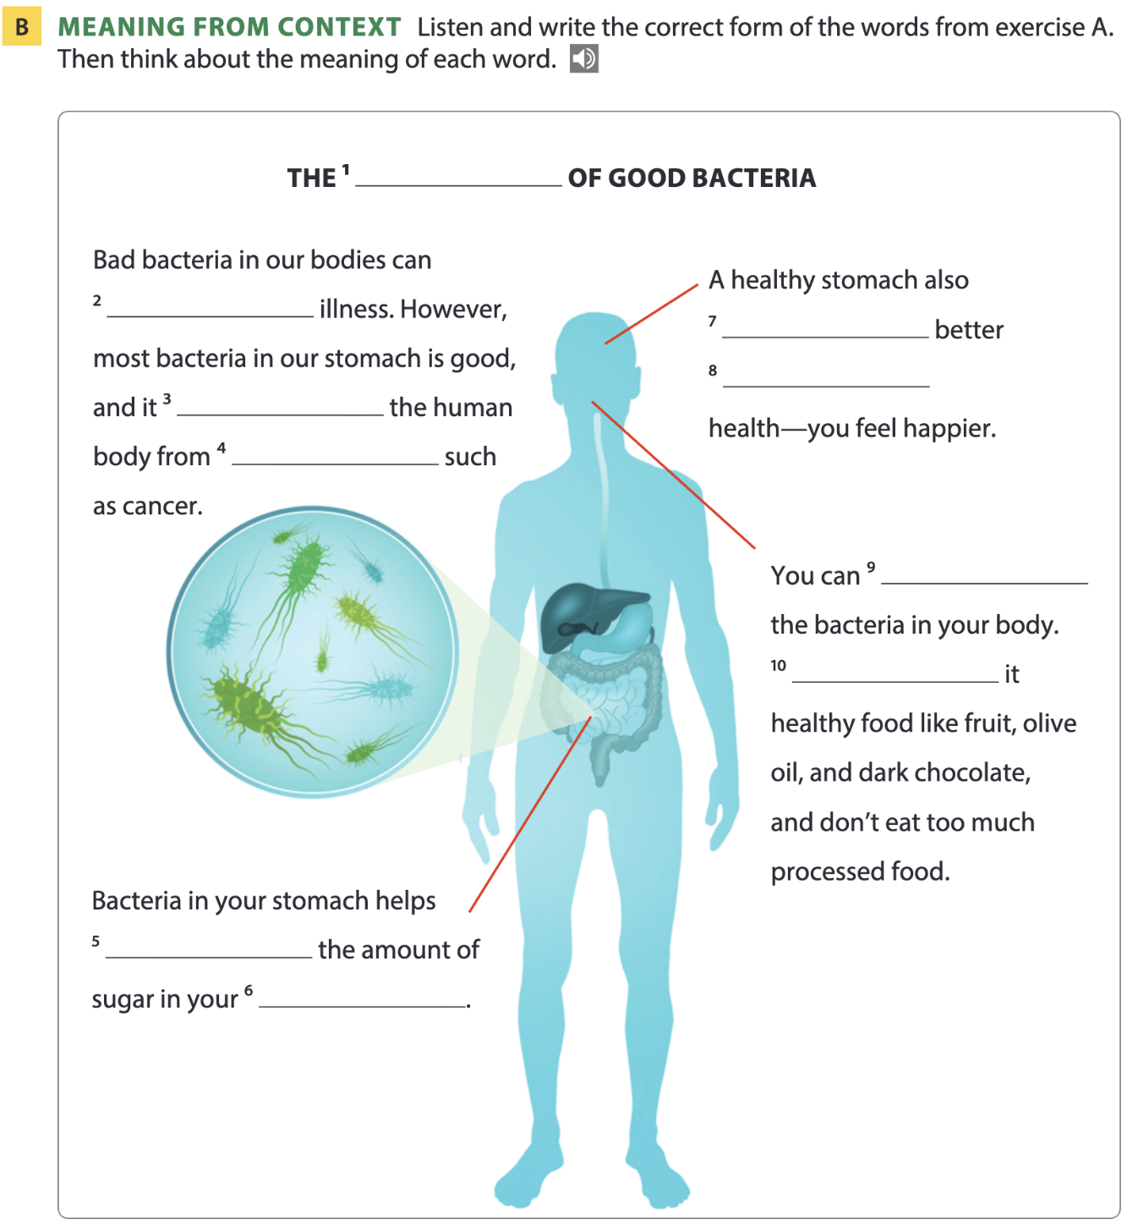
Page 132
Benefits
cause
leads to
mental
protects
diseases
improve
Feed
control
blood

Slide 30
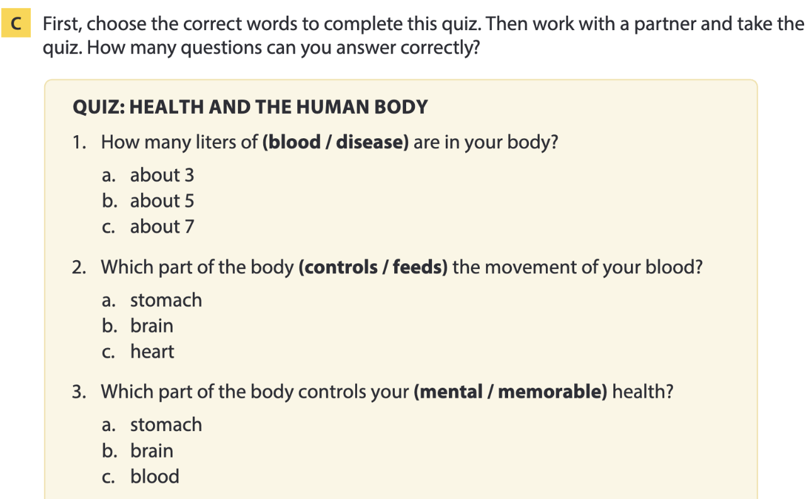
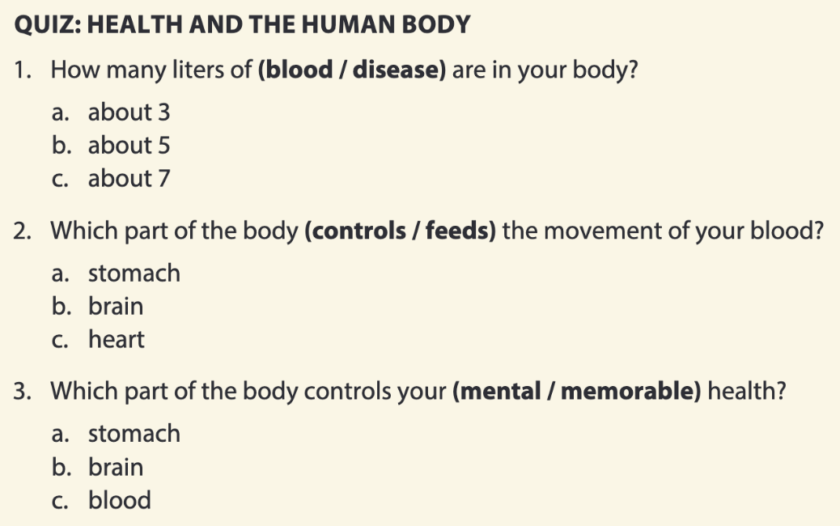
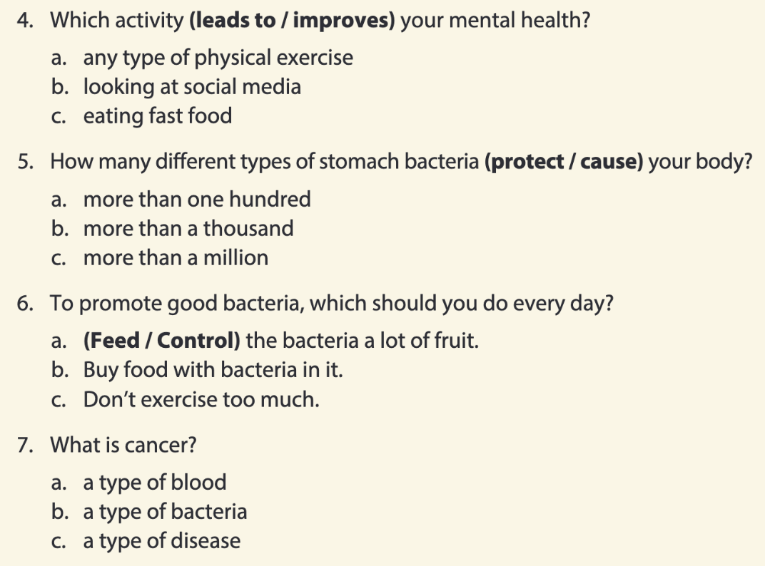
Page 133

Slide 31
05
Listening B

Slide 32
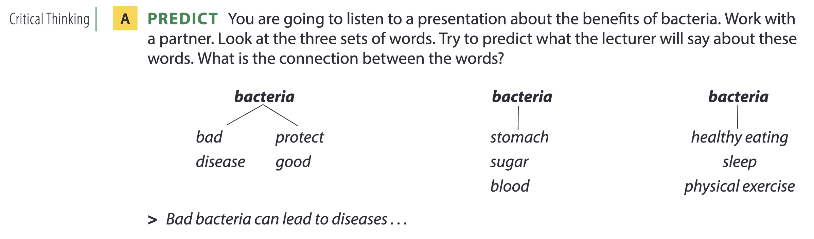
The benefits of bacteria

Slide 33
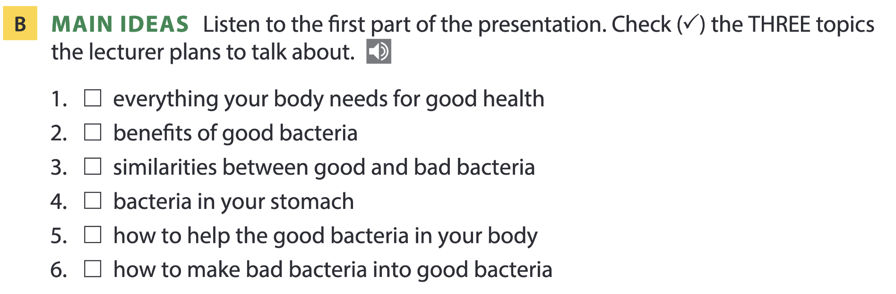

Page 134

Slide 34
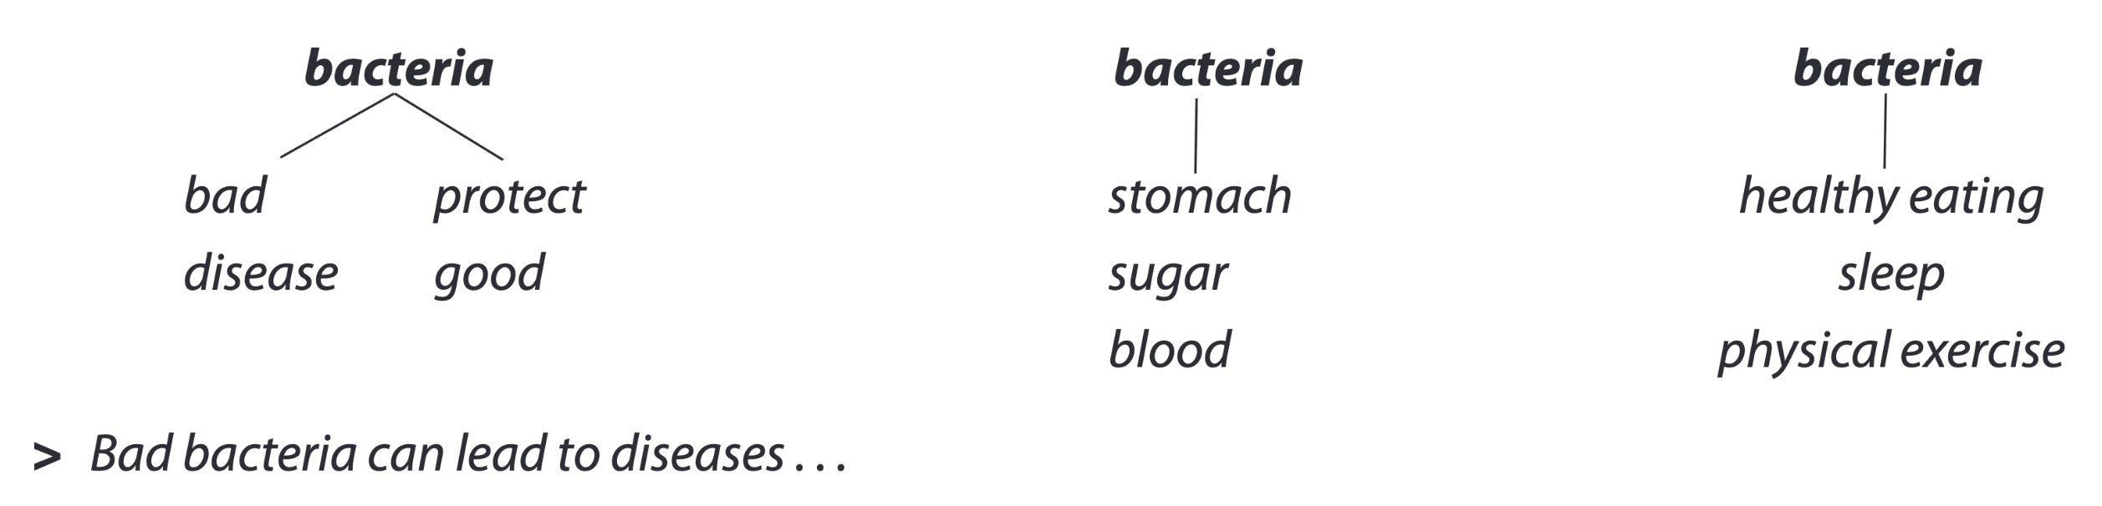
Page 134

Slide 35
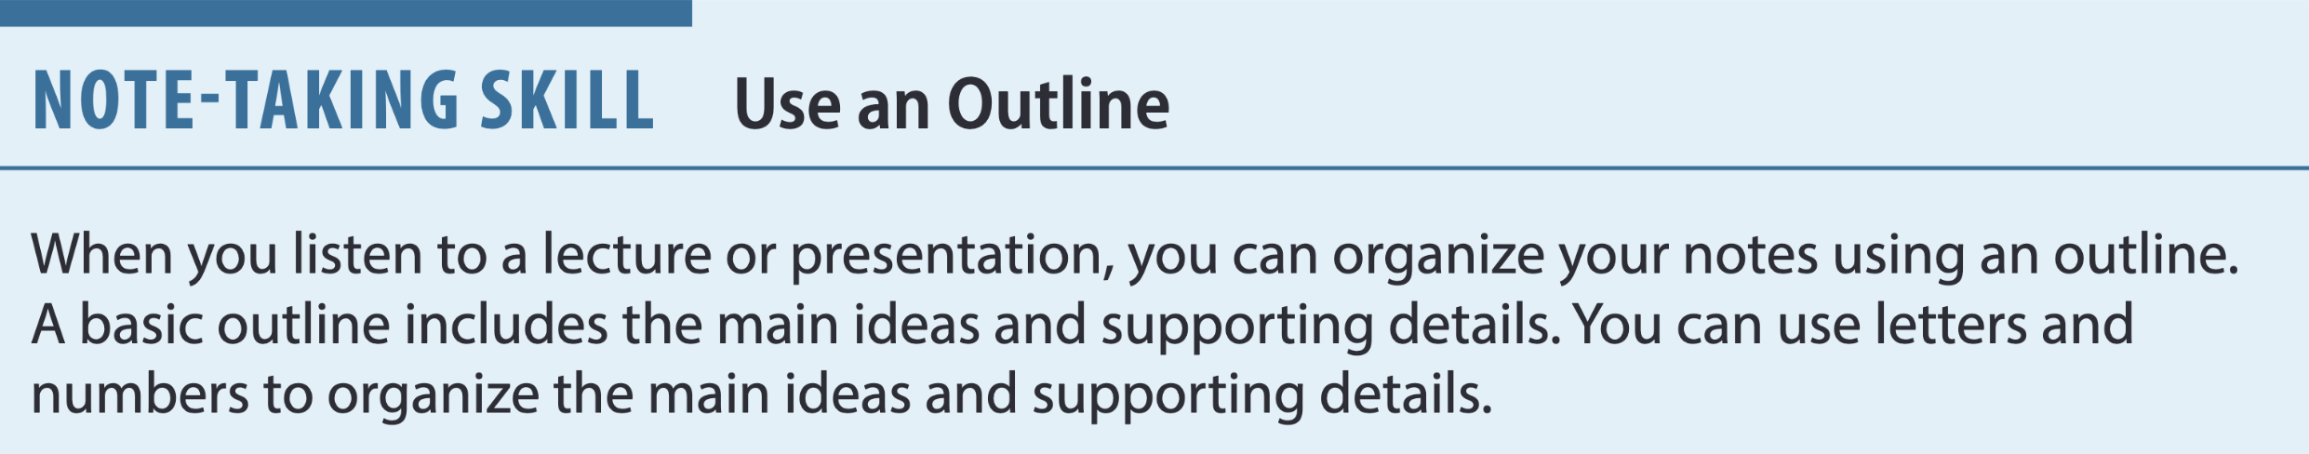
Page 134
Basic format of an outline:
Title or Name of Topic
1. First Main Idea
a. detail
b. detail
2. Second Main Idea
a. detail
b. detail
facts, examples, definitions, descriptions, etc.

Slide 36
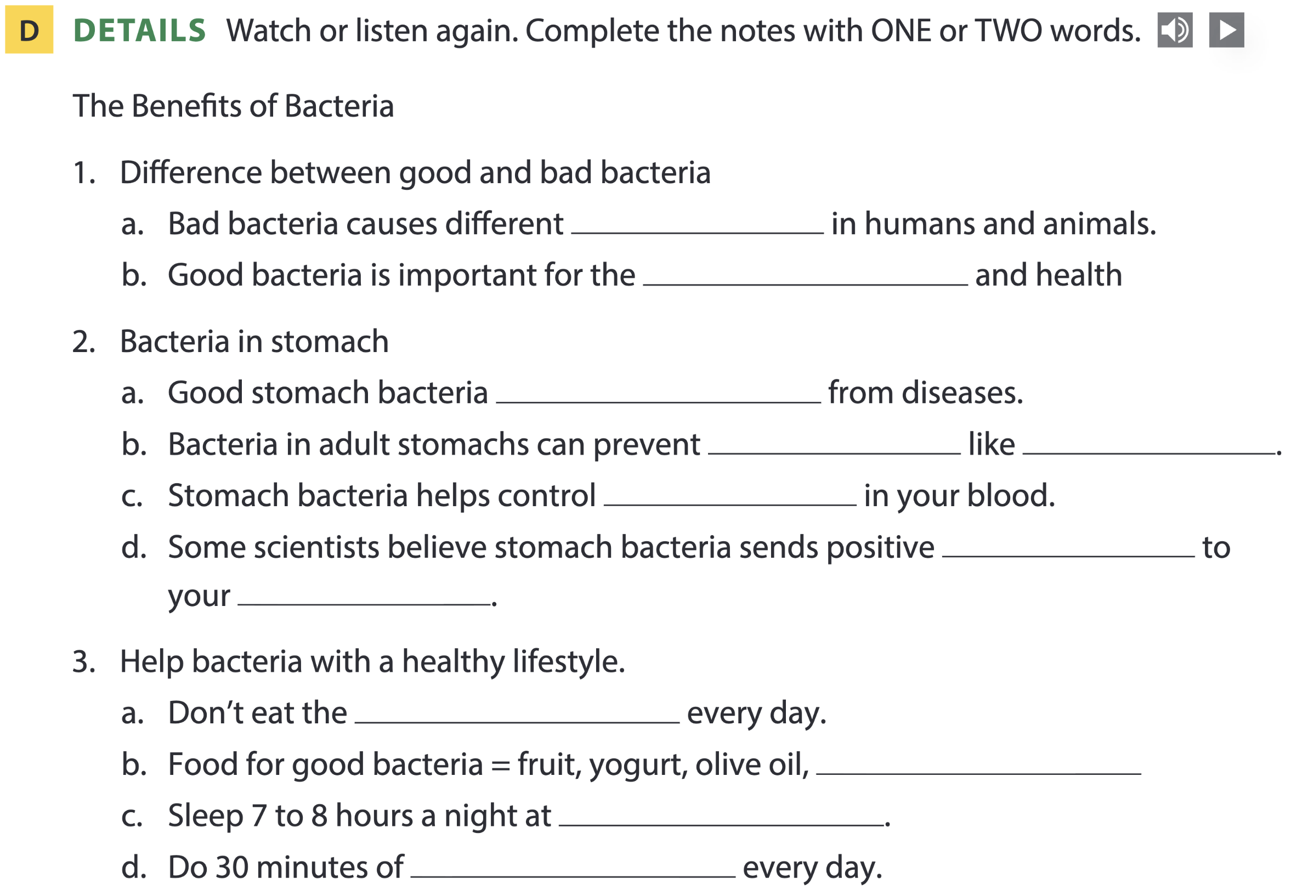
Page 135
diseases
human heart
protects babies
diseases
cancer
sugar
messages
brain
same thing
dark chocolate
regular times
physical exercise

Slide 37
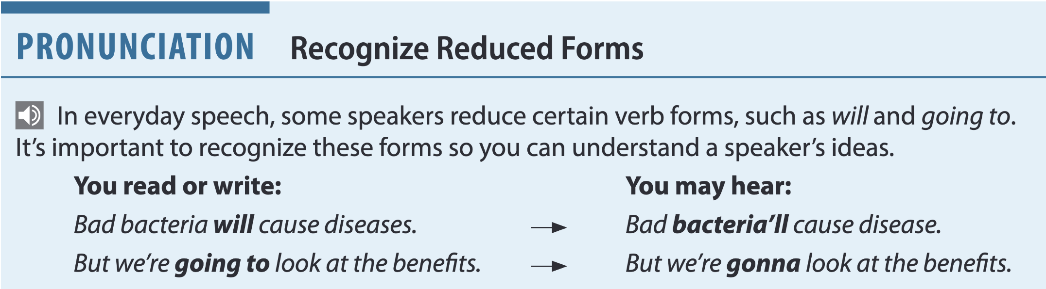
Page 135

Slide 38
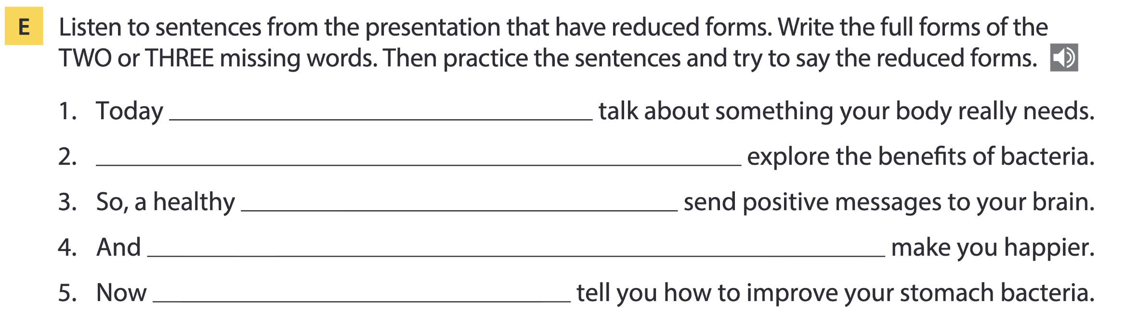
Page 135
I’m going to
We’re going to
stomach will
this will
I’m going to

Slide 39
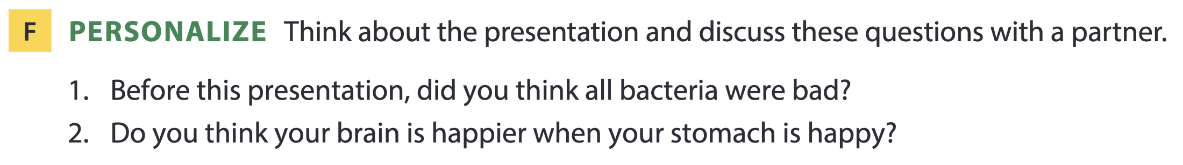

Page 135

Slide 40
THANKS FOR YOUR ATTENTION!

